Slide 1

CS-401
Computer Architecture & Assembly Language Programming
Lecture-33
Video Services

Slide 2

Lets revise the last lecture

Slide 3
Bios services

Slide 4
int 0x10 Video Services
Set Video Mode
AH = 0x00
AL = desired mode
al m chars p/c pixels cl pg add. Mode
00 T 40x25 9x16 360x400 16 8 B800 VGA
02 T 80x25 9x16 720x400 16 8 B800 VGA
03 T 80x50 8x8 640x400 16 4 B800 VGA
0D G 40x25 8x8 320x200 16 8 A000 VGA

Slide 5
int 0x10 Video Services
Set Text Mode Cursor Shape
AH = 0x01
CH = cursor start and options
CL = bottom scan line containing cursor (bits 0-4)

Slide 6
int 0x10 Video Services
Set Cursor Position
AH = 0x02
BH = page number
DH = row (0x00 top row)
DL = column (0x00 left column)

Slide 7
int 0x10 Video Services
Scroll Up Window
AH = 0x06
Al = number of lines
BH = blank attribute
CH = row of window’s upper-left
CL = column of window’s upper-left
DH = row of window’s lower-right
DL = column of window’s lower-right

Slide 8
int 0x10 Video Services
Write Char and Attribute at Cursor Position
AH = 0x09
Al = character
BH = page number
BL = attribute
CX = times to write

Slide 9
int 0x10 Video Services
Write Character at Cursor Position
AH = 0x0A
Al = character
BH = page number
CX = times to write

Slide 10
int 0x10 Video Services
Write Graphical Pixel
AH = 0x0C
BH = page number
Al = pixel color
CX = column
DX = row

Slide 11
int 0x10 Video Services
Write String
AH = 0x13
Al = write mode
BH = page number
BL = attribute
CX = number of characters
DH,DL = row, column
ES:BP = address of destination

Slide 12
Character Bitmap Display

Slide 13
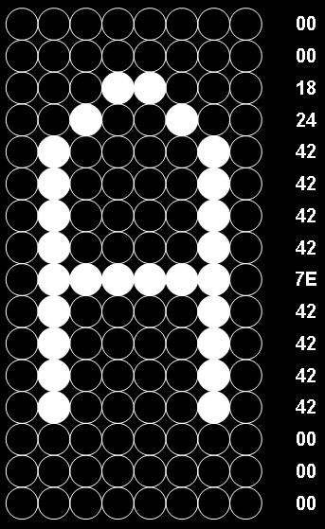
Character Bitmap

Slide 14
int 0x10 Chargen Services
Get Font Information
AH = 0x11
Al = 0x30
BH = font specifier (0x06)
Return
ES:BP = specified pointer
CX = byte/char of on-screen font
DL = hieghest char row on screen

Slide 15
int 0x10 Chargen Services
Text Mode Char Gen
AH = 0x11
Al = 0x10
ES:BP = user table
CX = count of character patterns
DX = char offset into map 2 block
BL = block to load in map 2
BH = number of bytes per pattern

